Slide 1

Breaking our ties with an immoral industry
#FossilFree gofossilfree.org/europe
Notes:
This is a presentation introducing the Fossil Free campaign, with a focus on the divestment campaign. Its aim is to get institutions all over the world to publicly cut their financial ties with the immoral fossil fuel industry.
These slides should take around 20 minutes to present, including a short film. There are notes to accompany each slide. We suggest you use these at the start of a wider meeting. Make time for questions and discussion. And add in detail to present your own campaign to new people in the blank slides at the end.
Slide 2 How divestment and sponsorship work sit under the Fossil Free banner
Slides 3-6 The history of the campaign, and how we’re winning!
Slide 7 How does the campaign work, a summary
Slides 8 - 9 Our theory of change - what the campaign is trying to achieve and how it does it
Slides 10- 16 Our organising principles - how we work together to campaign
Slides 17 - 18 Blank. Add in detail of your own campaign (unless your group is brand new)! Copy more slides if necessary.
Talk about when you started, who was involved, what you’ve done and what you’ve achieved. Share fun pictures of any actions.

Slide 2

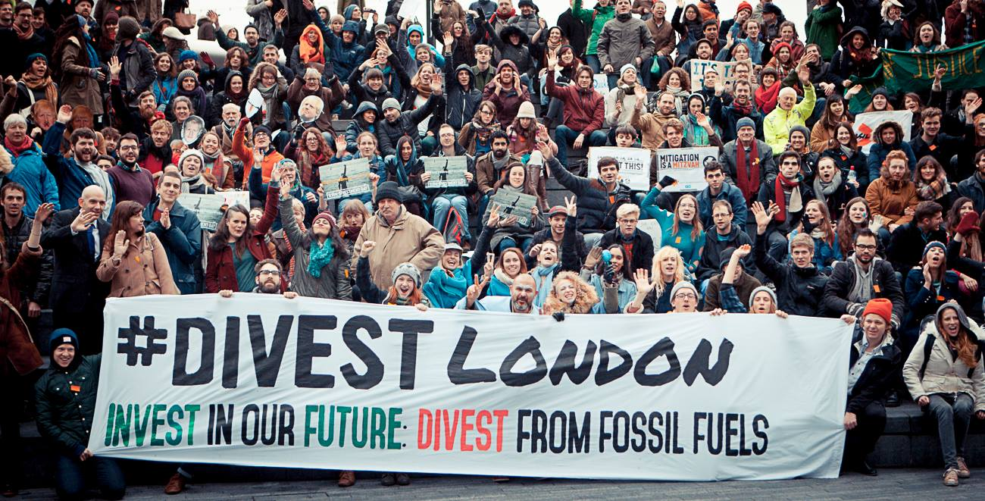
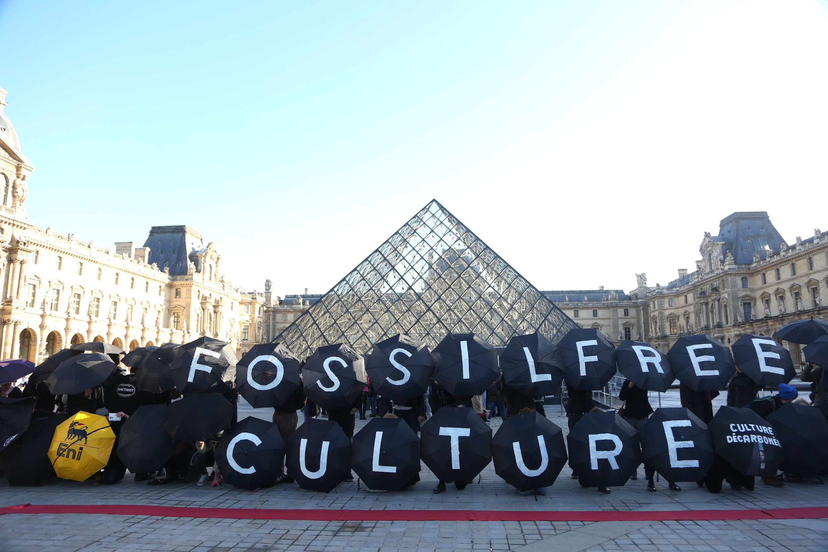
What is #FossilFree?
INVESTMENT
&
SPONSORSHIP
Notes:
This presentation is mostly focused on divestment - the withdrawal of investments to fossil fuel companies by institutions, often through things like pension funds, following public pressure.
But other work, campaigning against acceptance of donations or sponsorship of cultural institutions for example (like the campaigns to liberate the Tate gallery in the UK and the Louvre in France from oil company sponsorship) also comes under the banner of the Fossil Free campaign.
Fossil fuel companies cultivate relationships by sponsoring arts, sports and other institutions to help create a ‘social licence for them to operate’. This contributes to the veneer of legitimacy that enables them to keep expanding operations at a time of climate crisis and to stifle the demands for justice of those communities who live on the frontline of their destructive, polluting operations.
If we are to consider a future beyond fossil fuels, we can’t let people’s minds be manipulated by ‘big oil’. Corporate sponsorship poses a threat to the future we envision.

Slide 3
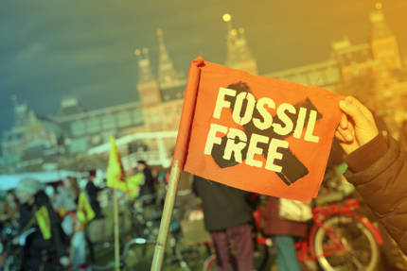
The Fossil Free campaign
is EVERYWHERE...
➨ Launched in 2012
➨ 1000s of campaigns
➨ 6 continents
➨ 730 institutions divested
➨ Fastest growing divestment campaign in history!
Notes:
The campaign is young but having started in the US in 2012 it has now spread all over the world. It’s the fastest growing divestment campaign in history!
The numbers are impressive, as we estimate that trillions of dollars have been divested. But the real point is not the money, it’s the impact that this has on the moral standing of the fossil fuel industry. We’re eroding public support bit by bit and more institutions publically cut their ties, and building the strong people powered divestment movement we need to tackle climate change.
You can check and update latest commitments here: https://gofossilfree.org/commitments/

Slide 4
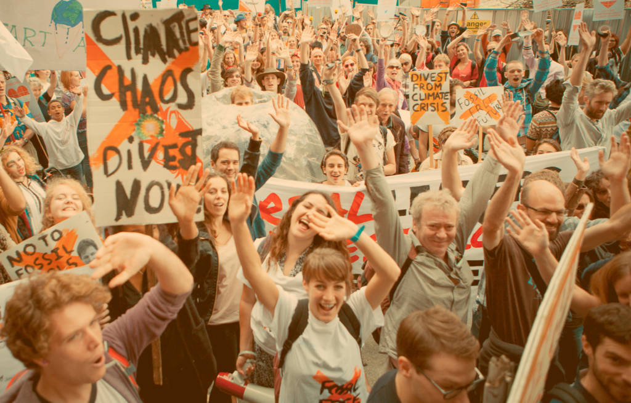
The divestment movement is WINNING
➨ Universities: Almost ⅓ in UK
➨ Capital cities: France, Germany, Norway, Sweden, Denmark
➨ Faith institutions: World Council of Churches
➨ Medical: British Medical Association
Notes:
There have been so many successes!!
- universities, nearly a third of universities in the UK have committed to divest so far. Over 100 campaigns running
- faith institutions like the World Council of Churches, the Quakers,
- medical institutions such as the British Medical Association and Berlin doctor’s pension fund
- cities including the capital cities of France, Germany, Norway, Sweden and Denmark
- the Rockefeller Brothers Fund, heirs to the Rockefeller oil fortune
- big sovereign state funds: Norway has divested from coal, and Ireland could become first country to divest from fossil fuels

Slide 5
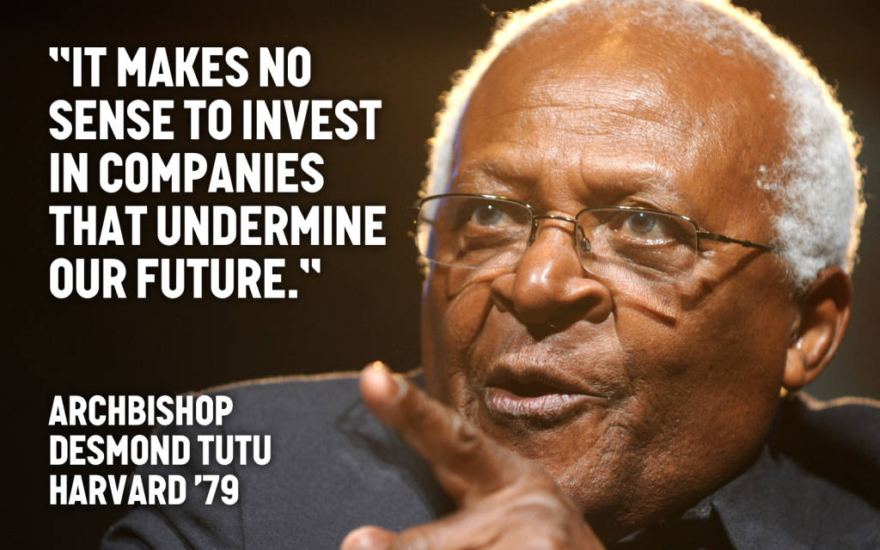
Notes:
The campaign has had endorsements from high-level figures such as
former Executive Secretary of the United Nations Framework Convention on Climate Change Christiana Figueres,
Nobel Peace Prize winner archbishop Desmond Tutu
Actor Leonardo DiCaprio
Author Naomi Klein

Slide 6
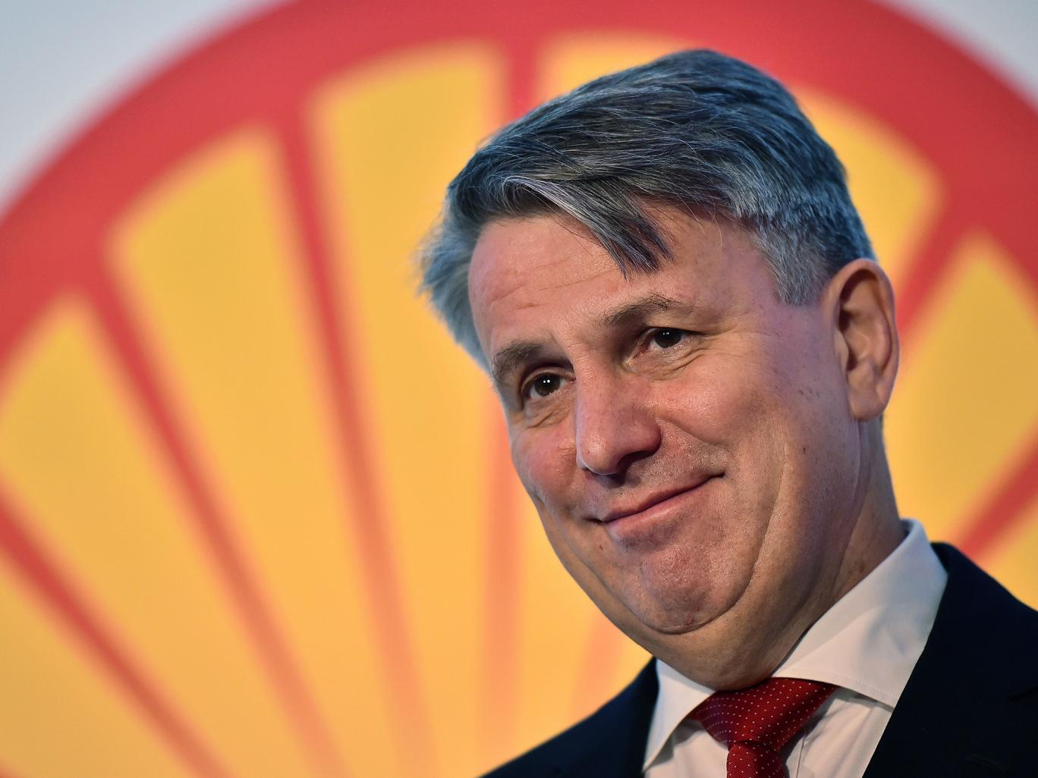
“This is the biggest challenge we have at the moment as a company ... the fact that societal acceptance of the energy system as we have it is just disappearing.”
Ben van Beurden,
CEO of Shell
Notes:
Shell CEO in march 2017 spoke publically about the fact that public support for the fossil fuel industry is just disappearing and said it was a huge challenge for them to navigate.
This is perhaps even more exciting, and really shows what impact the campaign is having - this is exactly what we’re aiming to achieve.

Slide 7
How does the campaign work?
Anyone anywhere can join or start their own Fossil Free campaign.
Each campaign group is autonomous but is built from the same DNA or building blocks:
➨ We share a Theory of Change for how divestment can tackle the climate crisis.
➨ We commit to the same organising principles for how we work together.
Notes:
Anyone anywhere can run this campaign, and we want them to! It will take all of us working together to tackle the climate crisis.
But we’re stronger together if we follow common principles.
The divestment campaign has 1) a theory of change, and 2) common organising principles.

Slide 8
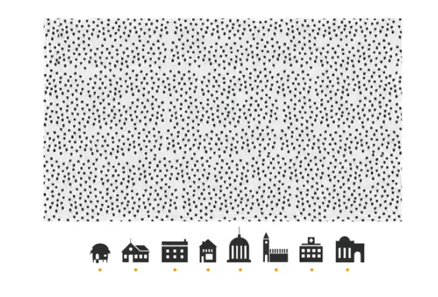
Our theory of change
https://youtu.be/_dApzI9jN04
Notes:
The best introduction is this film, just 2 mins long and can be viewed here: https://gofossilfree.org/europe/how
Key points:
We cannot allow any new fossil fuel projects - we need to phase out all those that already exist
Fossil fuel companies are the biggest obstacle to climate progress
They have lobbying power and get huge subsidies, and they’re blocking transition to a future powered by safe renewable technology
But people power can defeat them!
Since 2012 thousands of institutions, governments and individuals have divested
Fastest growing divestment movement in history
Divestment means moving invested money (and social acceptance) away from immoral industries
Takes power from fossil fuel industry and increases mandate for governments to take action

Slide 9
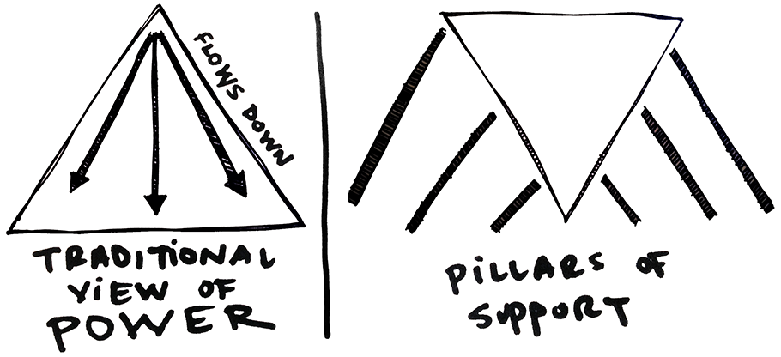
Our theory of change
https://youtu.be/_dApzI9jN04
Notes:
Many campaigns work by identifying a decision maker who has the power to make a change. They then try to persuade them, perhaps with research, or lobbying, or public pressure, to make that change.
This campaign is different. We’re trying to shift a whole industry. And we know we won’t do it by appealing to those in charge of fossil fuel companies. Other campaigns have tried this, and they’re making some progress, but they’re not winning the big transformational change we need.
Fossil Free is an industry-wide approach. We’re not focused on a single company, a single project, or a single sector (like coal). We need to push back on the narrative put forward by oil and gas companies pointing the finger at coal and calling for incremental change. Current oil and gas projects alone (even without coal), would take the world beyond 1.5°C. Specific examples, especially locally relevant ones, are useful but should be set within a framework targeting the fossil fuel sector as a whole.
Key to our theory of change is the idea of eroding pillars of support for the fossil fuel industry until it collapses. For the fossil fuel industry, the pillards supporting it (ie. our targets) are societal acceptance and the practical investments of our institutions like: pension funds, faith organisations, banks, universities, art and cultural institutions, wealthy people, opinion leaders, etc etc.
We’re building a strong people powered movement that is eroding support for the fossil fuel industry one step at a time, and we’re winning.
The money matters, but the biggest impact we’re having is on the industry’s reputation and its social licence to operate.
If you want to read more about how we think the Fossil Free campaign can bring about change, there’s a blog on ‘How we win’: https://gofossilfree.org/how-we-win/

Slide 10

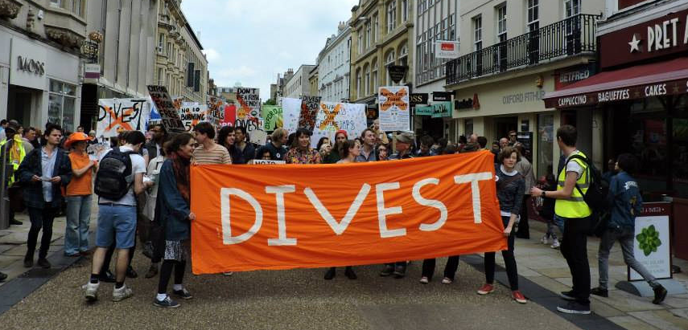


Organising Principles
We are inclusive
We are open source
We are all leaders
We take action
Notes:
Our principles for how we campaign together are also really important. We want to embody the values, ideas and ways of working we want to see in a just and sustainable future in the way we campaign to make that happen. These four principles govern the way divestment campaigns run all over the world.
You can see this online here: https://gofossilfree.org/europe/organising-dna

Slide 11
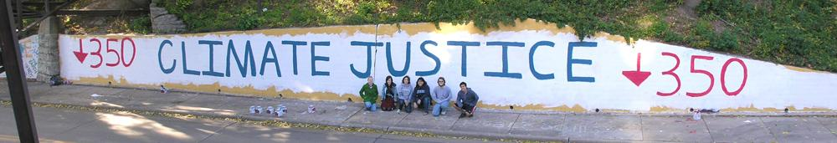
We are inclusive
➨ Climate change isn’t just an environmental, a social justice, or an economic issue — it’s all of those at once.
➨ We embrace and actively welcome the talents, energy & commitment of all individuals volunteering their time regardless of their background, ethnicity, religious or spiritual belief, gender and sexual orientation.
Notes:
Climate change isn’t just an environmental issue, or a social justice issue, or an economic issue — it’s all of those at once. We’re going to have to work together to solve it.
We embrace and actively welcome the talents, energy & commitment of all individuals volunteering their time regardless of their background, ethnicity, religious or spiritual belief, gender and sexual orientation. We react immediately against disrespect.

Slide 12
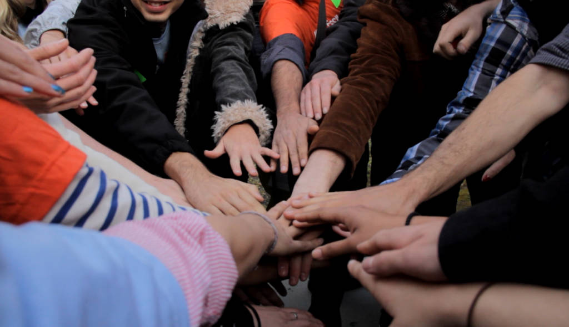
We are inclusive
➨ Our campaign is built on the relationships of its participants.
➨ We will work every day to build trust, respect and reciprocity among members of the Fossil Free divestment movement.
Notes:
Our campaign is built on the relationships of its participants. We will work every day to build trust, respect and reciprocity among members of the Fossil Free divestment movement.
There are details of a team building welcome exercise here: https://trainings.350.org/resource/diversity-welcome/
And of a selection of team building resources can be found here: https://trainings.350.org/topics/team-building/

Slide 13
We are open source
➨ We welcome anyone to use and adapt the Fossil Free name, the visual identity, the campaign tools and symbols of the divestment campaign if their actions, demands and communications are consistent with our organising principles and the campaign’s theory of change.
➨ We understand that a shared identity makes our movement stronger.
➨ We are all responsible for co-creating and maintaining that public image.
Notes:
Everything is open source. That means our tools are available to everyone campaigning for fossil fuel divestment following our theory of change and embodying our organising principles.
You can find a style guide which talks through everything you need for a visual identity which helps the campaign be recognisable here: https://gofossilfree.org/style-guide/ and the logos are here: https://gofossilfree.org/logos/
But this also means we’re all responsible for co-creating and maintaining the public image. It’s really important. We’re more powerful if we work together, in the same way, to achieve the same goal.

Slide 14
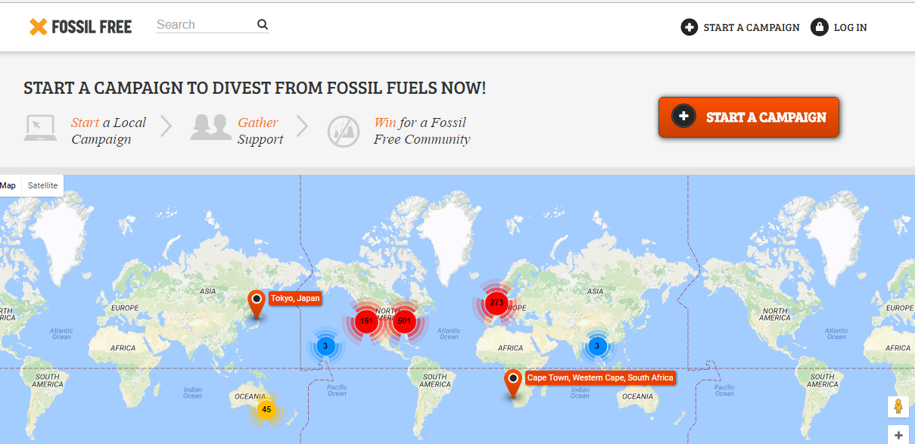
Fossil free campaigns
Notes:
There is an excellent guide online to how to use the Fossil Free site. It talks through:
How to set up a petition
How to promote that petition
How to email people who have signed that petition with updates to your campaign
How to collect signatures offline and input them
How to deliver your petition
How to organise campaign events - and more!
https://gofossilfree.org/europe/wp-content/uploads/sites/7/2016/09/how-to-use-fossil.pdf

Slide 15
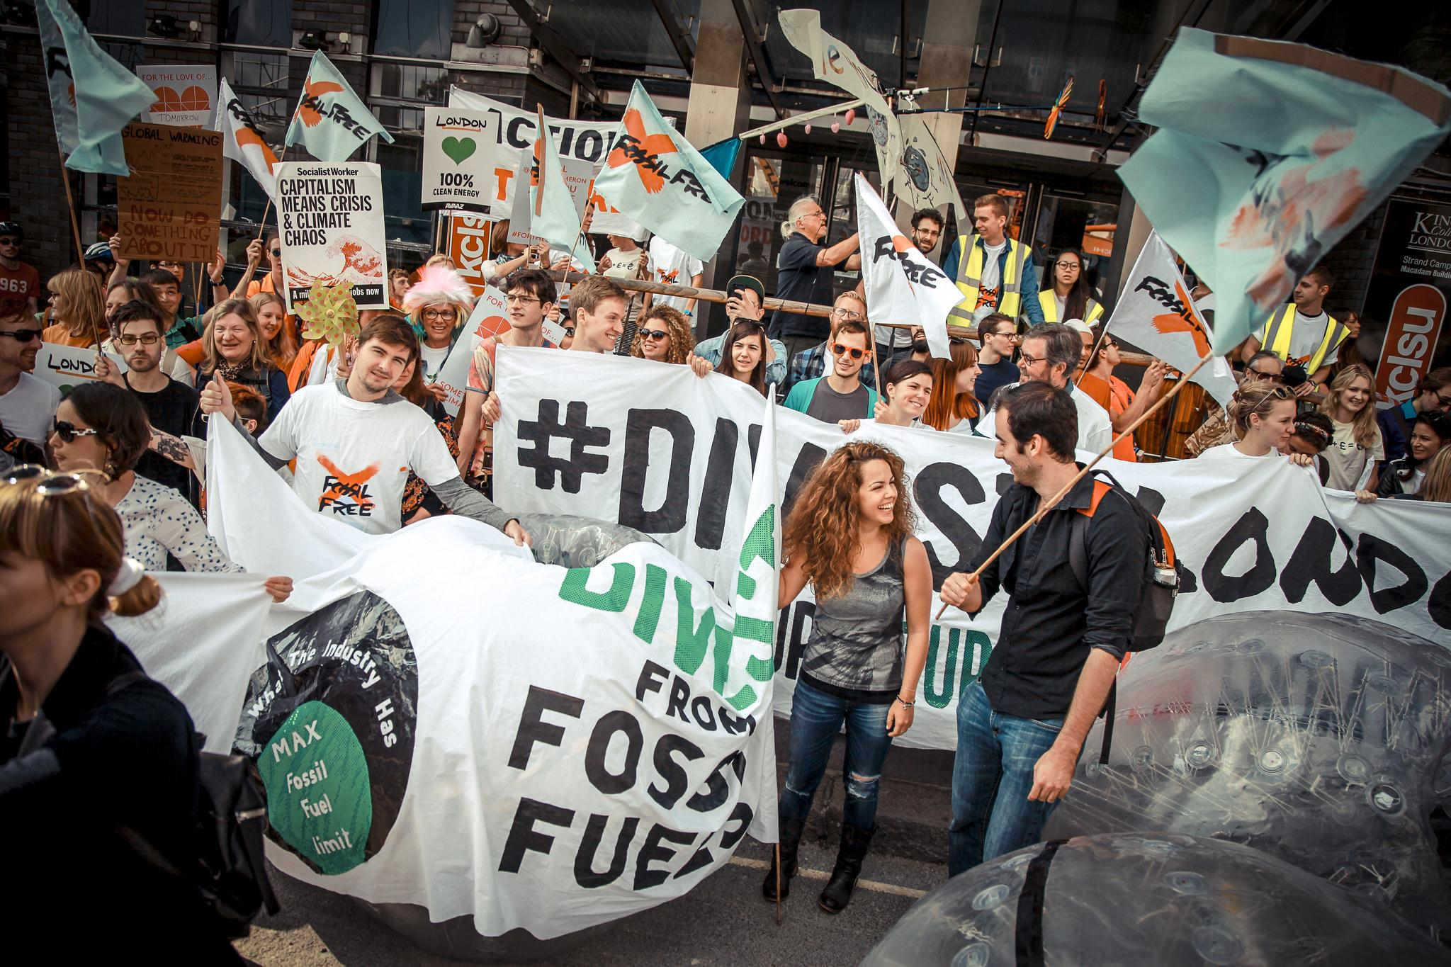
We are all leaders
➨ Fossil Free groups are autonomous
➨ BUT all organising, facilitation, decision making, communications, tactics and actions are consistent with these principles & theory of change.
Notes:
Fossil Free groups are autonomous and responsible for ensuring their organising, facilitation, decision making, communications, tactics and actions are consistent with these principles and the campaign’s theory of change.
We encourage a variety of decision-making tools and processes within campaigning groups.
This can range from consensus on key strategic decisions and thorough consultation to inform ‘big’ decisions, while entrusting day-to-day decisions to working groups and smaller teams.
Basically, it’s up to groups how they manage their internal processes and group decisions / discussions. BUT the principle we are all leaders is an important one. There will be people who have been involved a long time and who take on different bits of responsibility at different times, but there shouldn’t be any one person or small number of people in charge.
You can find guidance on facilitation here: http://trainings.350.org/for/meeting-facilitators/#facilitation
And on group decision making here: http://trainings.350.org/resource/how-to-help-a-group-make-decisions/

Slide 16
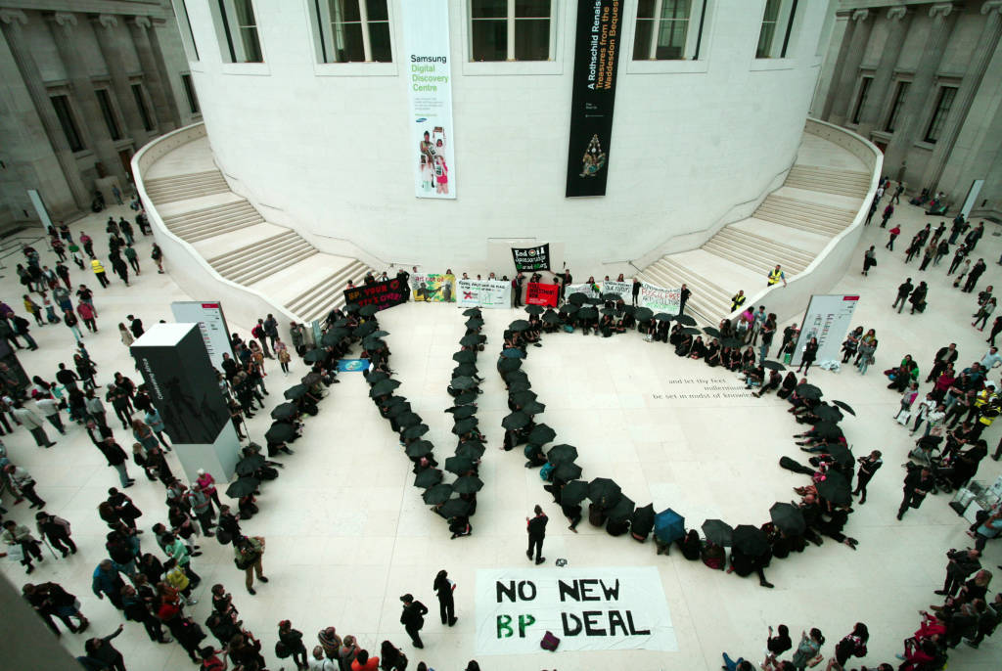
We take action
➨ Plurality of tactics strengthens our movement
➨ Public action builds public support
➨ We don’t use violence
➨ We escalate if demands are not met
➨ Some of us take direct action
Notes:
We encourage a plurality of tactics — it strengthens our movement.
We understand the role of public action in mobilising a critical mass of public support behind our cause.
And we recognise the importance of escalating those actions when our demands aren’t met. You can find a guide to escalating campaigns here: https://gofossilfree.org/europe/escalation-guide/
We are committed to maintaining non-violent discipline in all of our actions.
We support those who take direct action and respect those who are not in a position to take part.
Insider tactics like lobbying, using research, meeting directly with decision makers - these can be useful. But because success for Fossil Free means shining a light on the immoral activities and impacts of the fossil fuel industry, taking aim at its public reputation, taking action should mean building public support for the campaign.

Slide 17
Notes:
Slide blank for you to update on your campaign. How did you start? What is your strategy? Who is in the group? Who are you targeting? What have you done so far? And what is next?

